Slide 1
Recommander system
It biblichor
rafed

Slide 2
Plan
Multithreading
Extract & Load optimisation
Function optimisation
RESULTS
NEXT STEPS

Slide 3
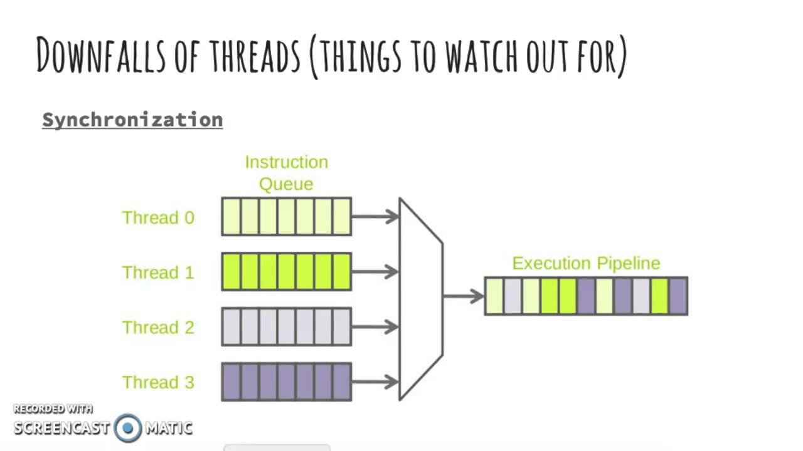
I. Multithreading

Slide 4
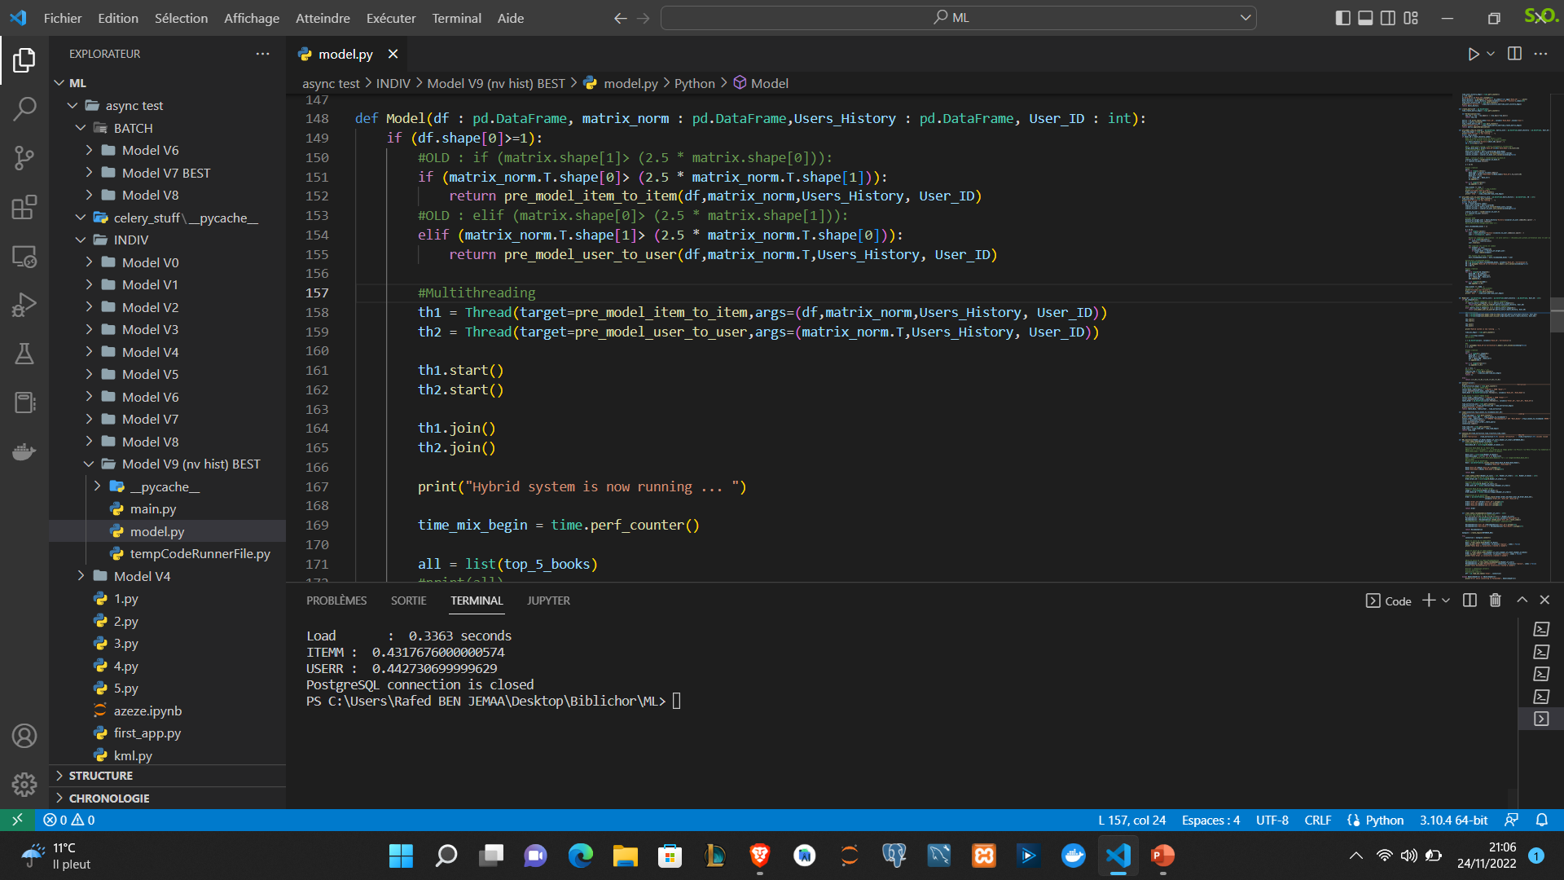
Multithreading in Our model

Slide 5
How ?
User-to-User
Item-to-Item
MIX
Thread 1
User-to-User
MIX
Thread 1 & 2
Item-to-Item

Slide 6
Extract & load optimisation
Psycopg2
SQL Alchemy

Slide 7
III. Function optimisation
Merging_Tables
Users_History | Exp 5000- 5000 – 5000 : 0,8s ➔ 0,039s

Slide 8
iv. Results
 | BEFORE OPTIMISATION | AFTER OPTIMISATION
50 – 50 -50 (batch)
500 – 500 – 500 (batch)
1000 – 1000 – 1000 (batch)
5000 – 5000 – 5000 (streaming)

Slide 9
V. Next steps
CLUSTERING SUR USERS
CLUSTERING SUR BOOKS
RUN SUR LES 2 CLUSTERS

